Slide 1




Smart Attendance management System
Team details
Hardik Arora, Hemant Prajapati, Shiven Rastogi - 3AC
Divyanshu Rajoria, Amitabh Singh – 3AD
Harsh Raj – 3AE

Slide 2
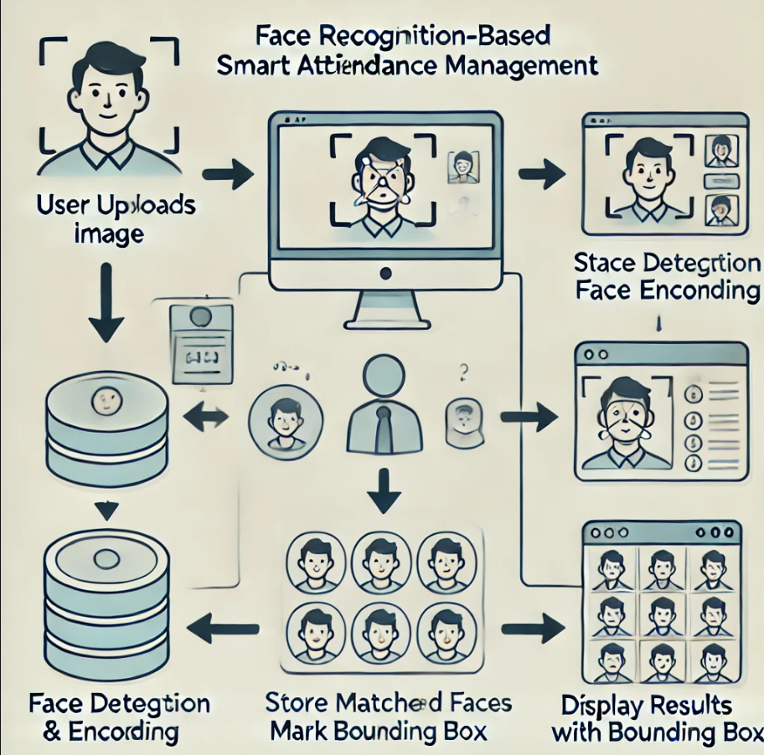
Idea/Approach Details
A Face Recognition-based Attendance System automating attendance tracking using Flask, OpenCV, and Face Recognition.
✔ Register New Individuals – Upload an image to store face encodings.
✔ Face Recognition – Identify registered individuals from an uploaded image.
✔ Flask Web Interface – Simple UI for interaction.
✔ Persistent Data Storage – Uses pickle for storing face encodings.
✔ Bounding Box with Names – Displays detected faces with names.

Slide 3
Dependencies /Challenges
Technology stack
• Flask – Web framework for UI
• OpenCV – Image processing
• Face Recognition – Face detection & encoding
• NumPy – Data processing
• Pickle – Data storage
• Requires high-quality images for accurate recognition.
• Proper lighting conditions improve detection.
• Managing large datasets efficiently.
Computationally intensive for real-time processing.
Security concerns regarding stored face data.

Slide 4
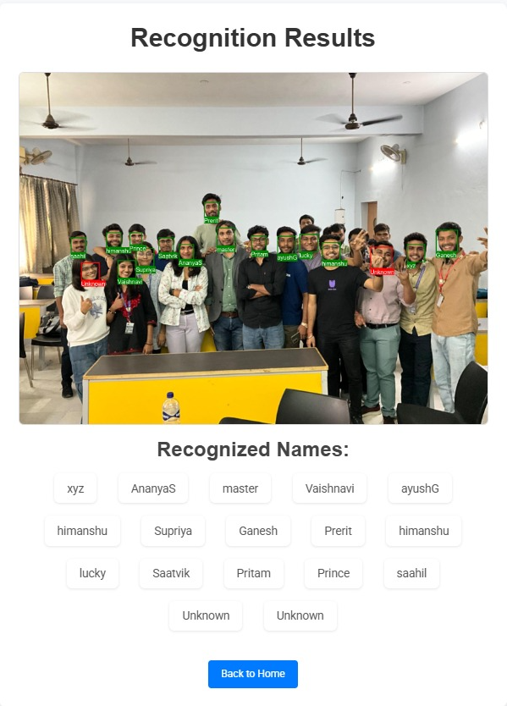
Innovation and Uniqueness:
• Automates attendance with minimal manual effort.
• Real-time face recognition for efficient tracking.
• User-friendly web interface for easy interaction
Supports multiple image formats for flexibility.
Scalable for large organizations and institutions

